Slide 1
Student Interest System BY : JAMSHAID MEHMOOD ROLL NO : BITF20M032

Slide 2

HELLO!
This is JAMSHAID MEHMOOD.

Slide 3
Todays Agenda :
ER Diagram
Technology used
Reason of using this stack
Flows of my project

Slide 4
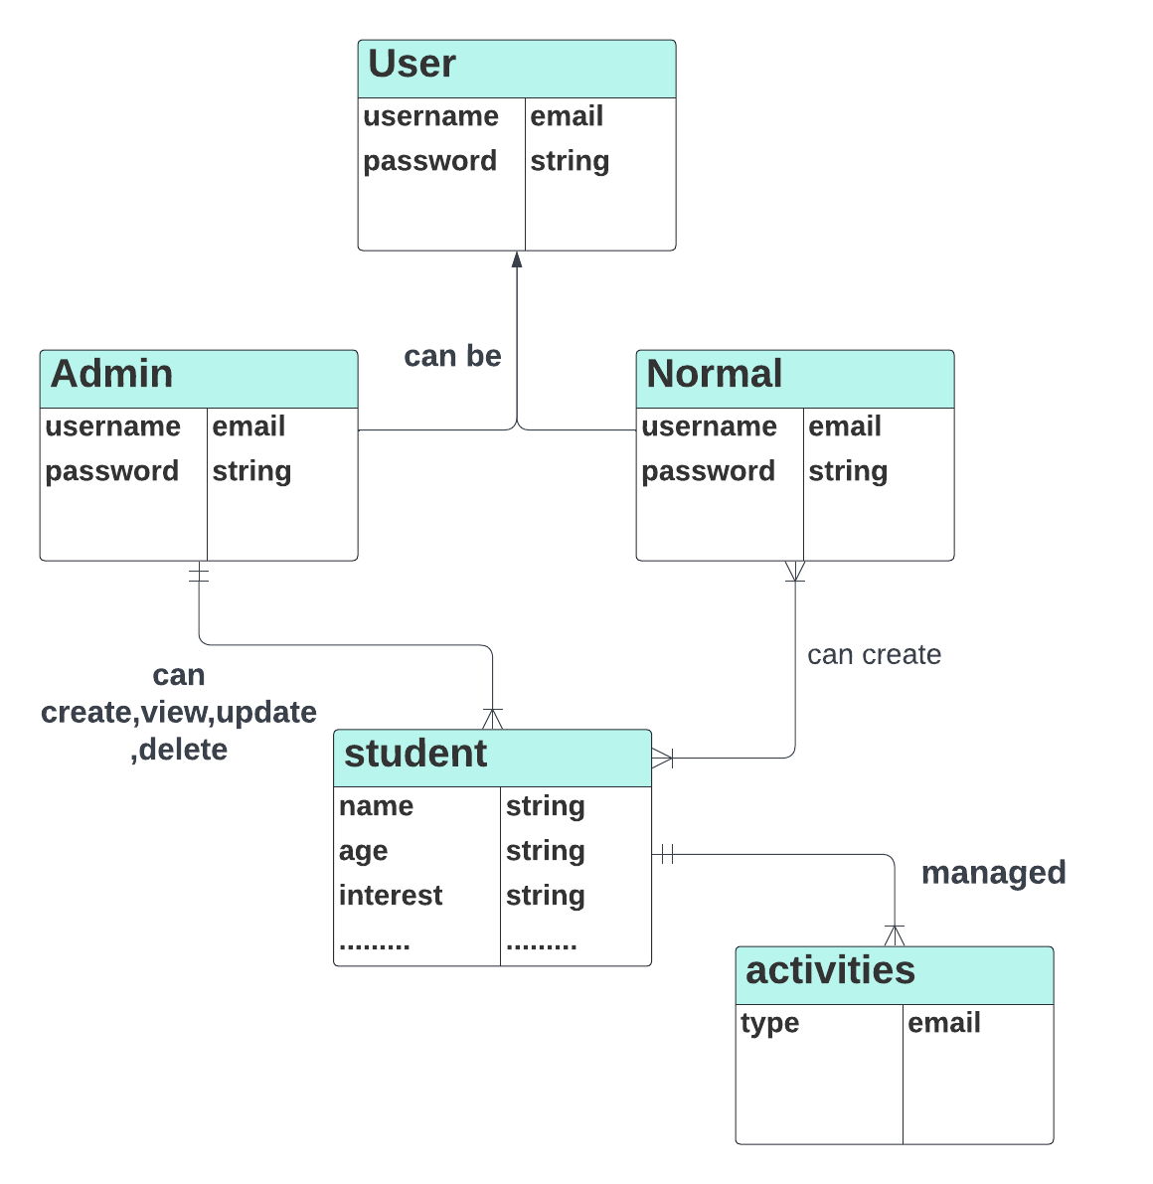
ER Diagram
Although I have used no SQL data base having no concept of relations.
But still the ER Diagram according to my implementation will be as shown:

Slide 5

Technology Used
Express js
Html
CSS
JavaScript
Mongo Db
Node JS

Slide 6
Reason to Use
Easy to handle the requests
Mongo dB is very fast and its no relational environment makes it less complicated
parsing request bodies
Main reason to use this is because of my exposure as I have done many projects using node JS

Slide 7
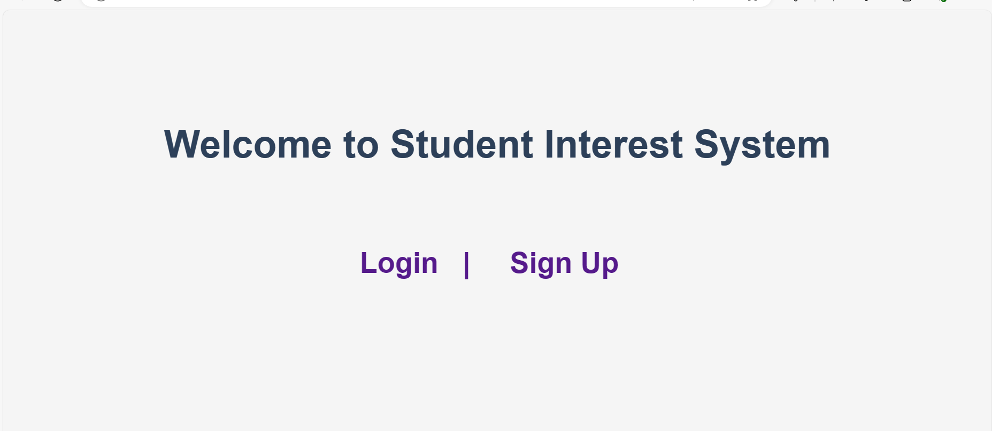
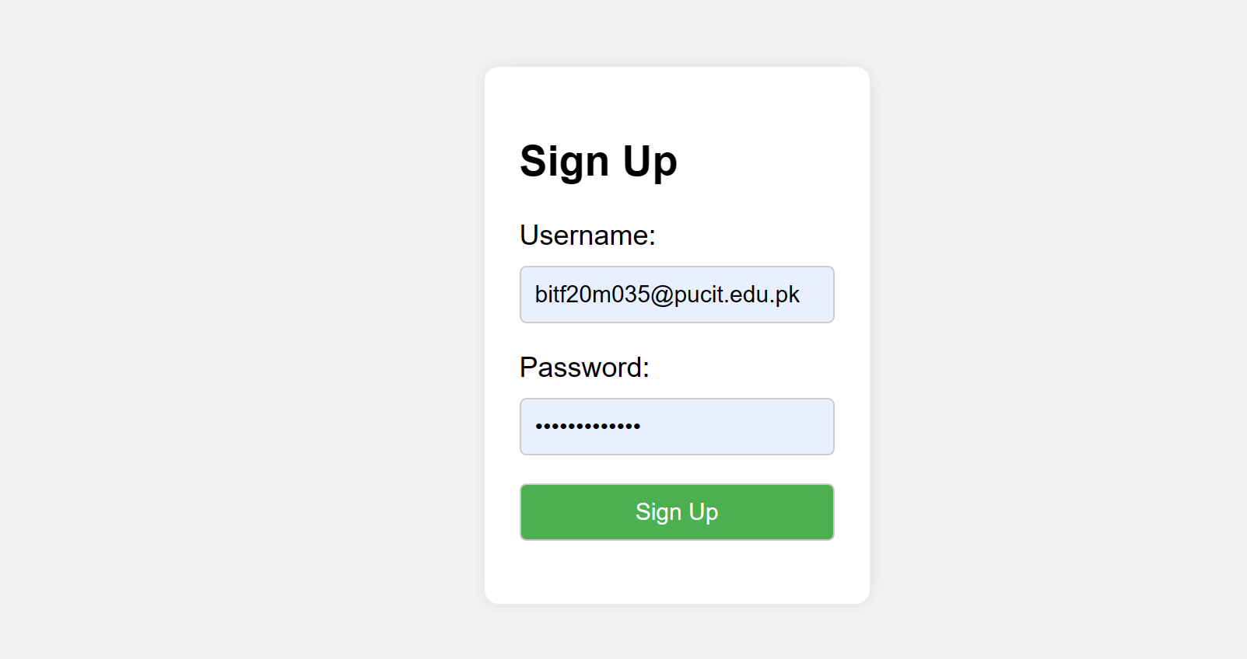
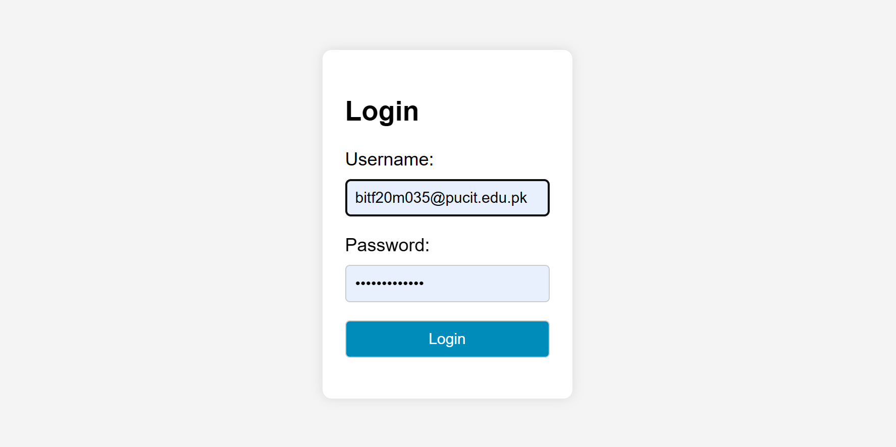
Flows
Click Sign Up
Register user
Login

Slide 8
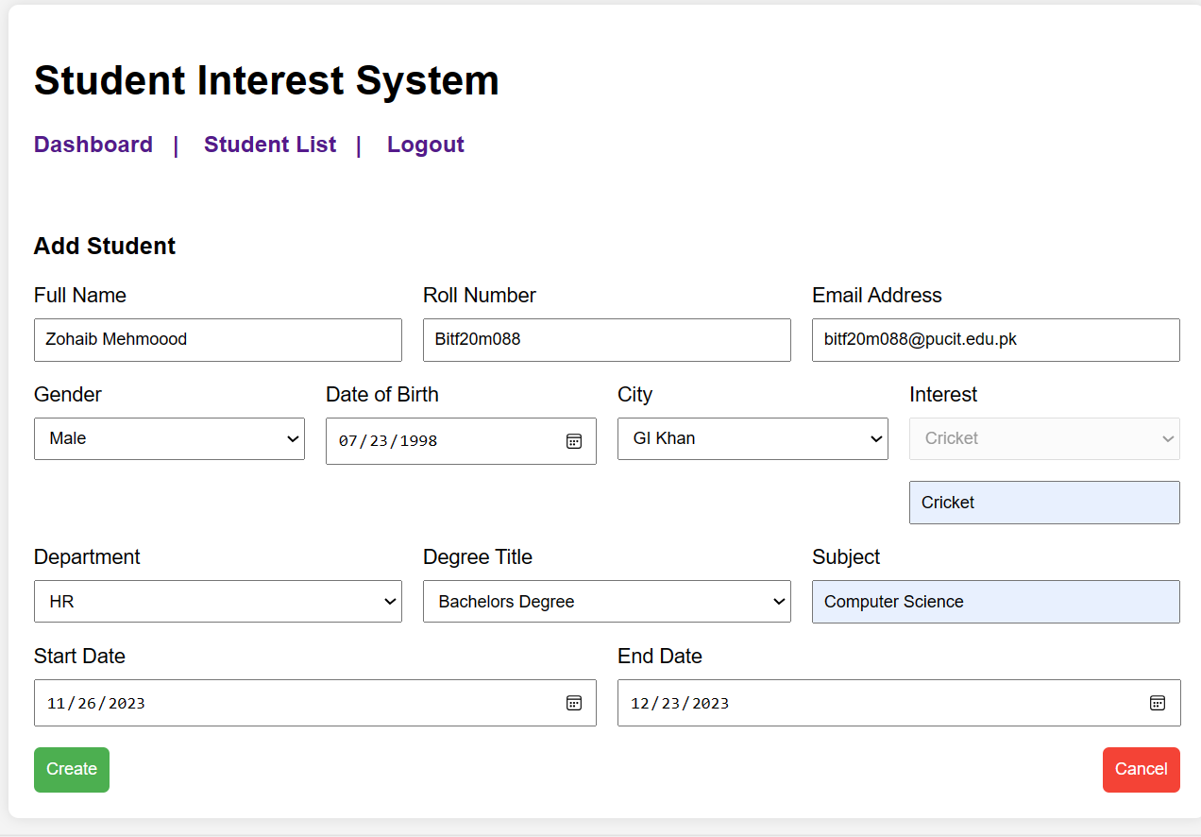
Flows

Slide 9
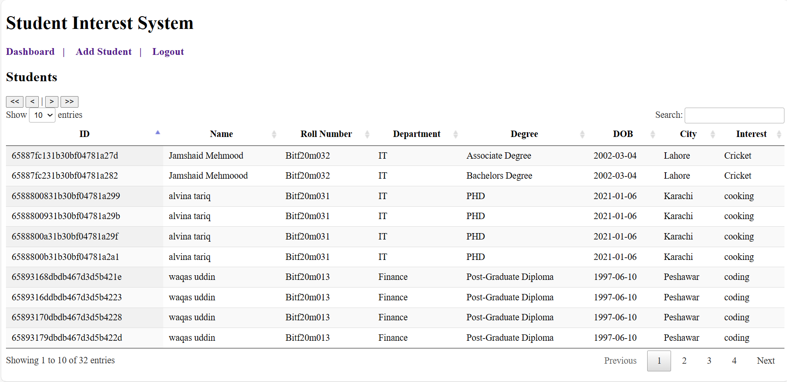
Flow

Slide 10
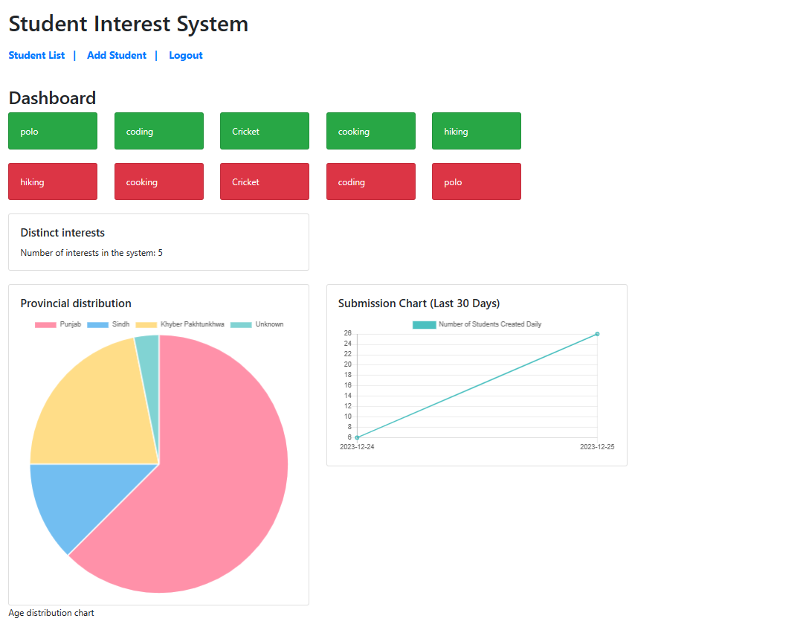
Flow

Slide 11
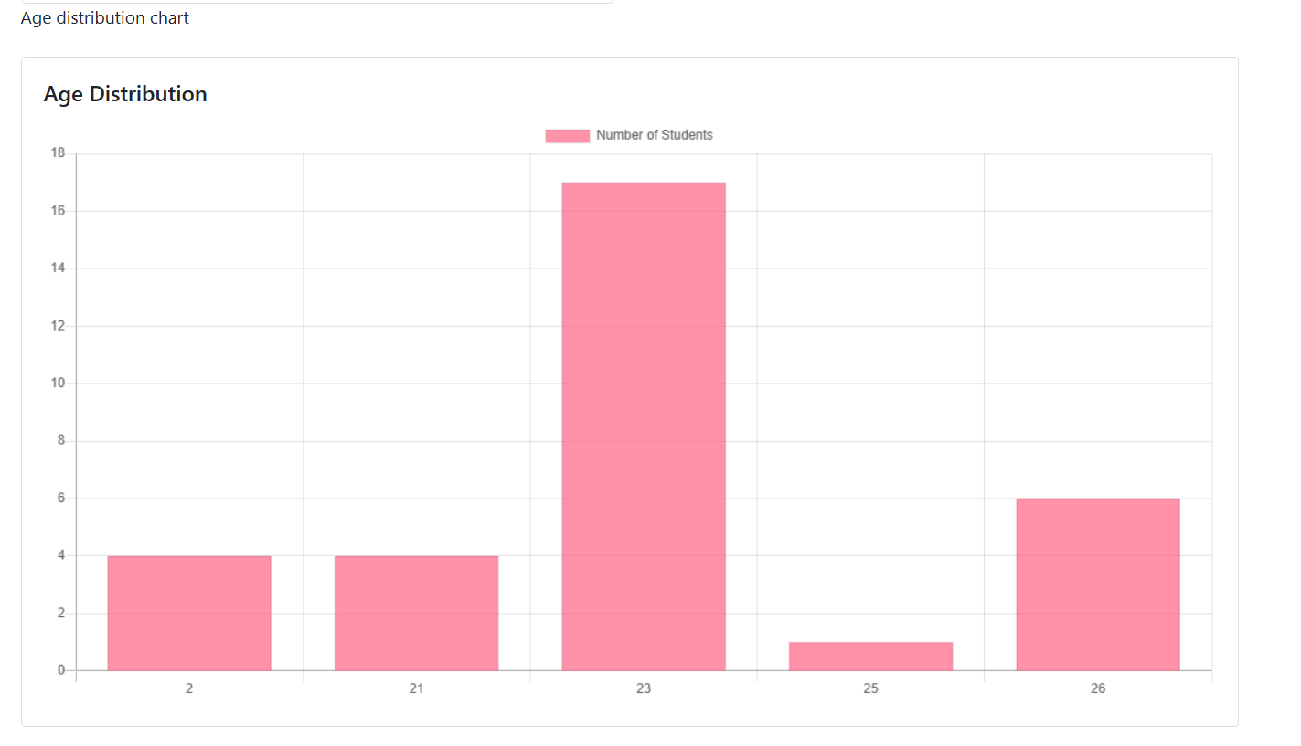

Slide 12
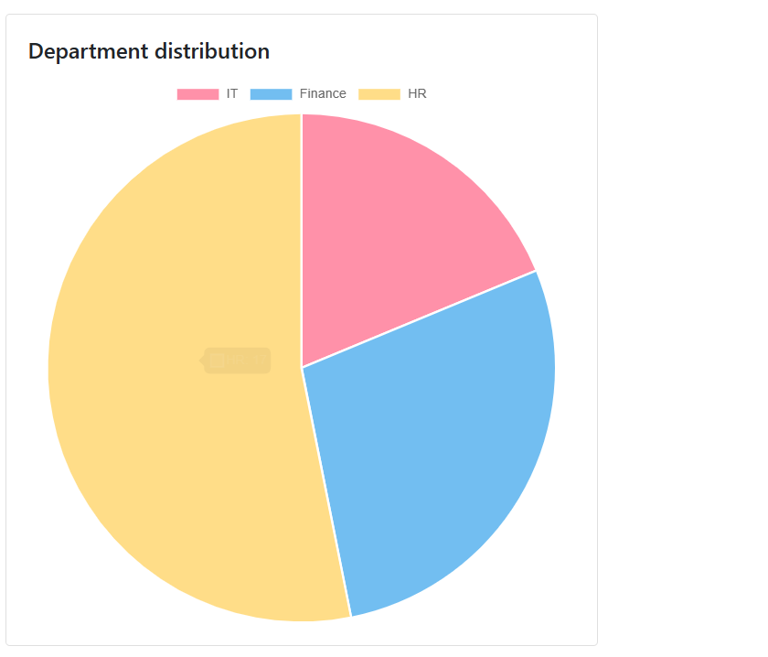
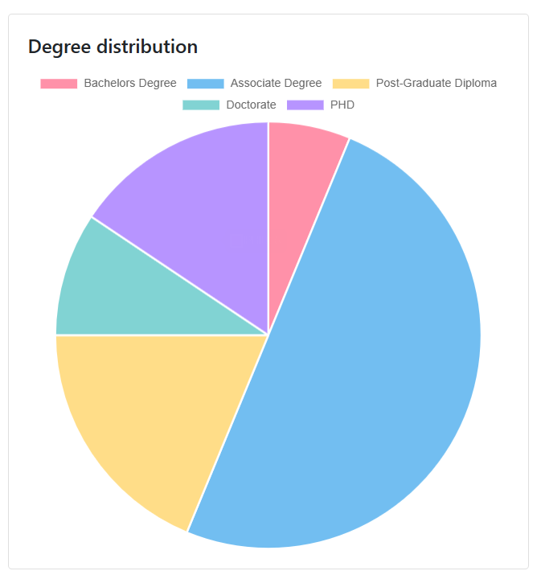
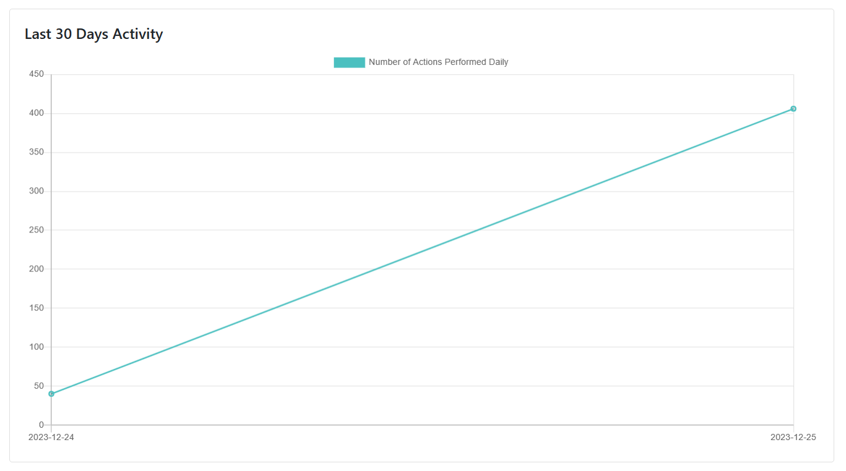

Slide 13
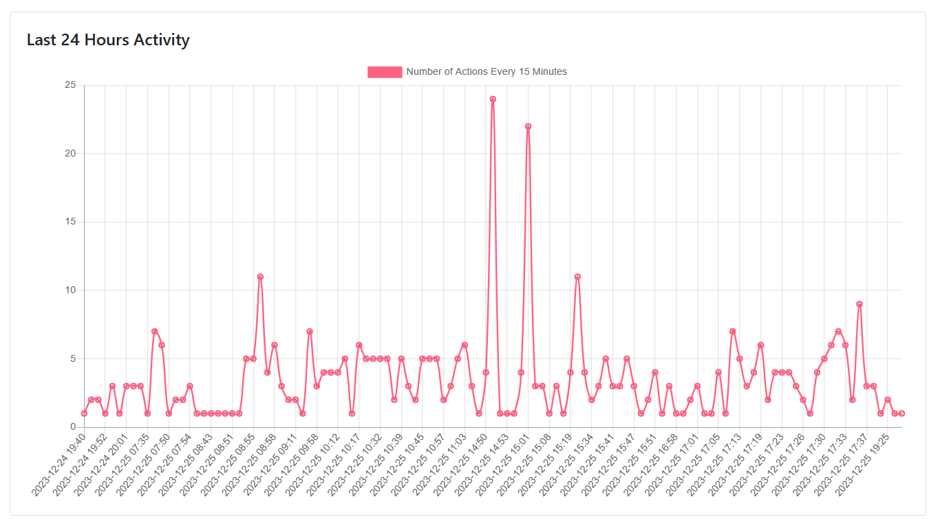

Slide 14
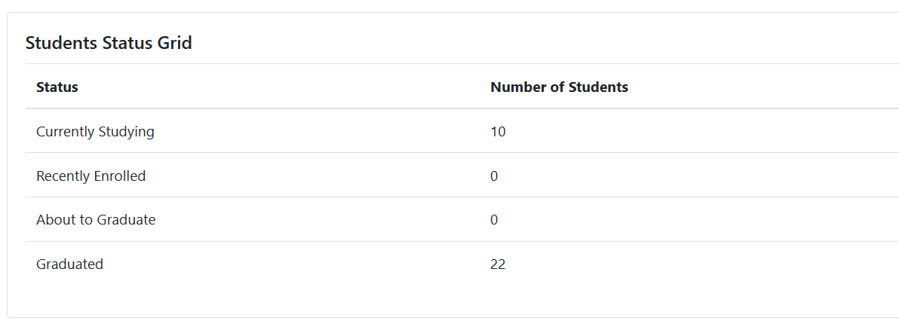

Slide 15
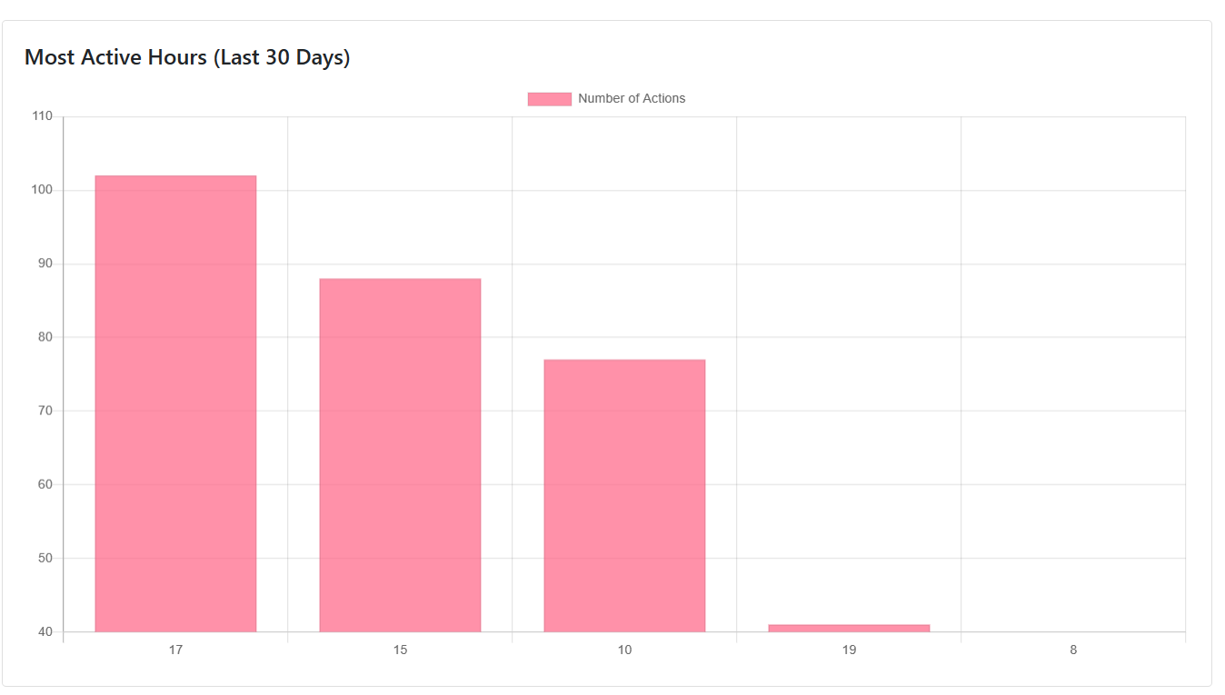
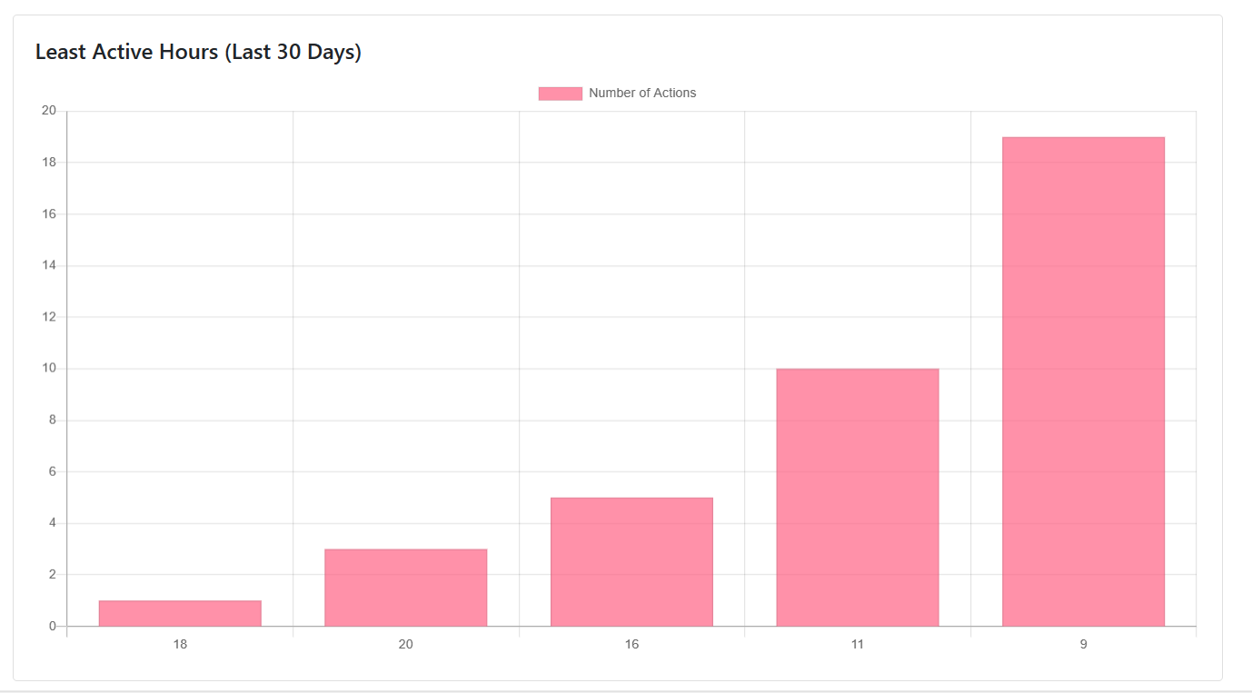
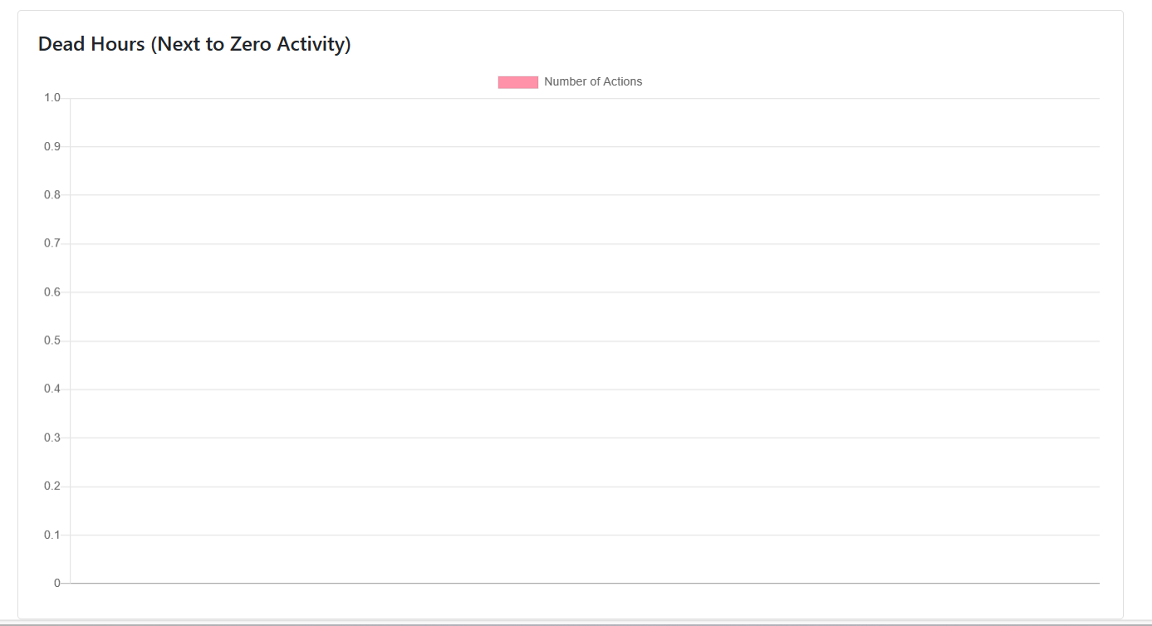

Slide 16
THANKS!
Any questions?

